Slide 1
CARBON AND ITS COMPOUNDS

Slide 2
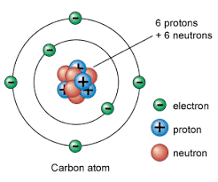
CARBON
Atomic number : 6
Mass number : 12
Electronic configuration of the carbon
atom : 1s 2s 2p
Valency of the carbon : 4

Slide 3
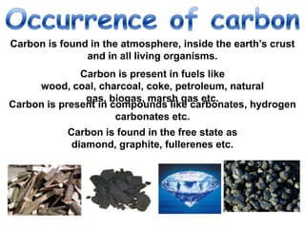
OCCURANCE OF CARBON

Slide 4
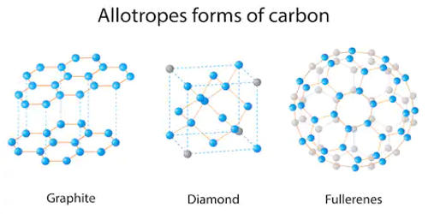

Slide 5
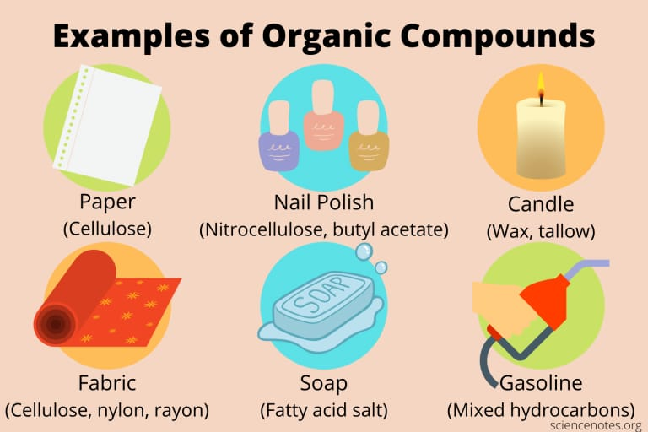
ORGANIC COMPOUNDS
These are the compounds of carbon and hydrogen with other elements like oxygen,nitrogen,sulphur etc..
Eg:
CO , NaCN ,CO2 ,CH4 etc..

Slide 6
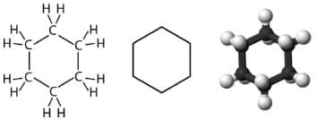
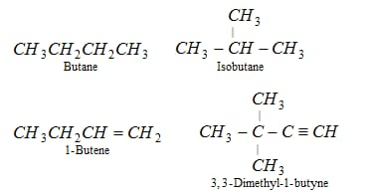
CLASSIFICATION BASED ON THEIR CARBON CHAIN
Acyclic or open chain compounds
Cyclic compounds

Slide 7
HYDROCARBONS
The organic compounds that are composed of only carbon and hydrogen atoms
Eg:
Methane , ethane , butane are one of the hydrocarbons

Slide 8
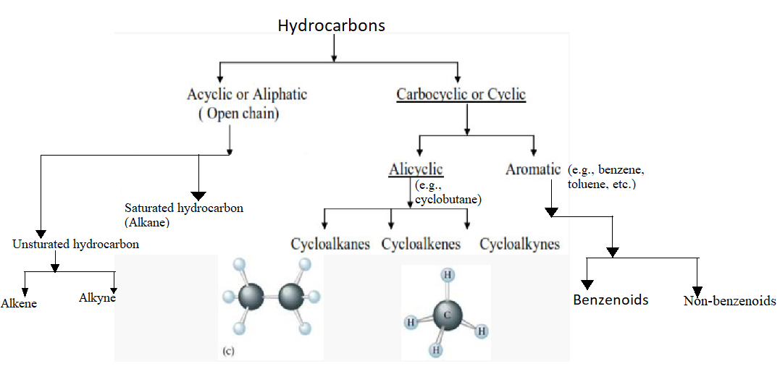

Slide 9
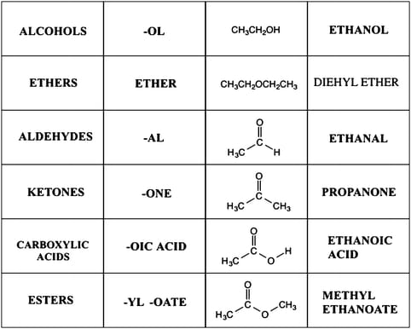
IUPAC NOMENCLATURE
IUPAC : International union of pure and applied chemistry

Slide 10
ETHANOL : CH3 CH2 CH2 OH
Step : 1
The parent chain consist of three carbon atoms
Root word : Prop
Step :2
Single bond between carbon atom of the chain.
Primary suffix : ane

Slide 11
Step : 3
The compounds contain OH group in the chain
It an alcohol
when the numbering system strats from the OH connecting carbon atoms
Step : 4
The locant number strats from OH group is 1
The secondary suffix : 1-ol

Slide 12
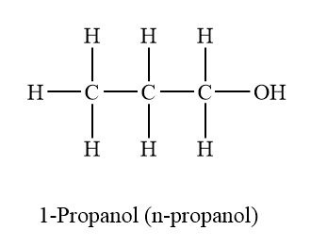
Step : 5
The name of the compound is
Prop +ane +1-ol =1- Propanol

Slide 13
THANK YOU

